Slide 1
Booktique
(Library Management System)

Slide 2
Booktique
(Library Management System)
Initiation Phase (1 – 2 weeks) | Coding and Development (3 – 8 weeks) | Transition Phase/Project Closure (9-10 weeks)
Finalizing the Project and Defining the Project Requirements and Specifications by participating in sessions/discussions with Amit Sir and Shubham Sir. | Finalized the Database Structure(i.e. rows and columns) with the help of SRS (Software Requirement Specifications) document. | Completed the work of Session Management and also completed the Librarians Panel.
Deciding the Technology Stack used in the Project for development and created a small working prototype in Java, to find the expected outcome | Created Admin Portal, which have basically 4 panels i.e. Member, Librarian, Books and Transactions | New Intern Vasudha joined, discussed the technology stack with her and also shared the code through GitHub (Version Control).
With the help of mentors and using different tutorials learnt about working of JSP /Ajax and MySQL. | Added some features like Pop Up Modal Box, Download as CSV, Mark as Deleted etc. | Doing KT Sessions with Vasudha and learnt about the JSON/Google API’s for creating/generating reports.

Slide 3
Booktique
Applications
Login through EID and Password
Database connection is done through JDBC API for MySql connector.
Librarian Add/Update/Mark as Delete
Member Add/Update/Mark as Delete
Transaction Issue Book and Return Book
Show Updated Records All Through
Key Features
Dynamic Modal Box using Bootstrap for Add functionality. (Pop Up Box)
Download As CSV
Session Management
Mark As Deleted (Creates an archive deleted entity)
Search Panel
Technology Learnt
HTML 5/CSS/Javascript (for Web Development)
JSP (for designing web pages)
JSP Implicit Objects (Request, Response, Session)
Ajax (Search panel)
JSON/ Google Chart API’s (for Report Generation)

Slide 4
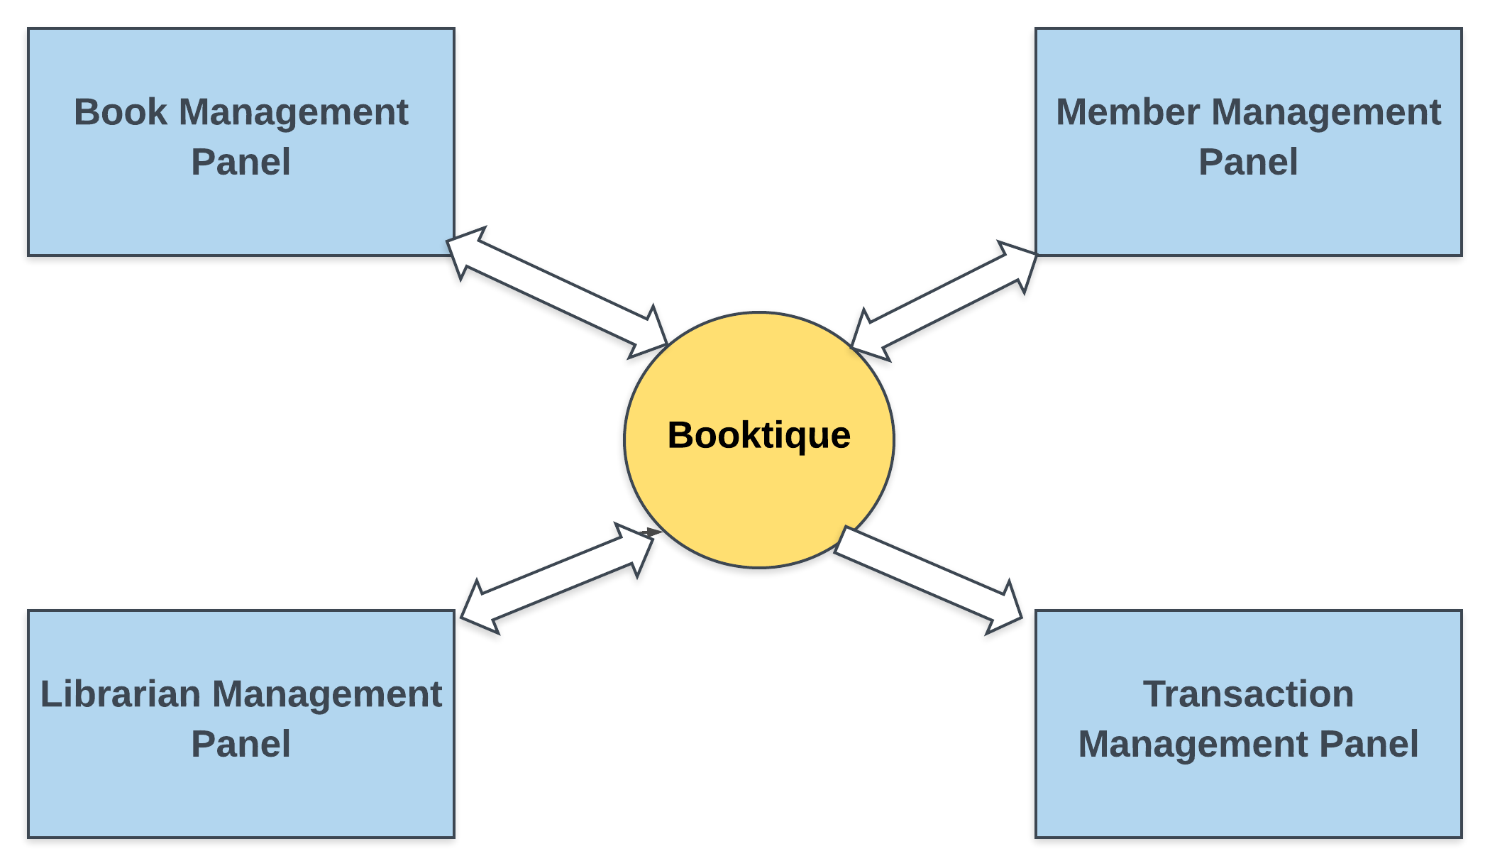
System Flow Diagram

Slide 5
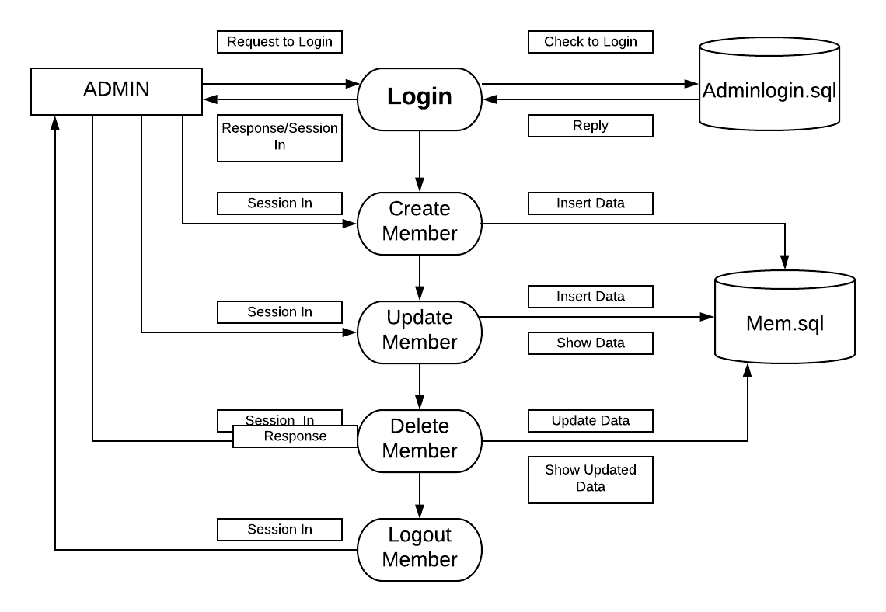
Admin Pane(Member) DFD 1st Level

Slide 6
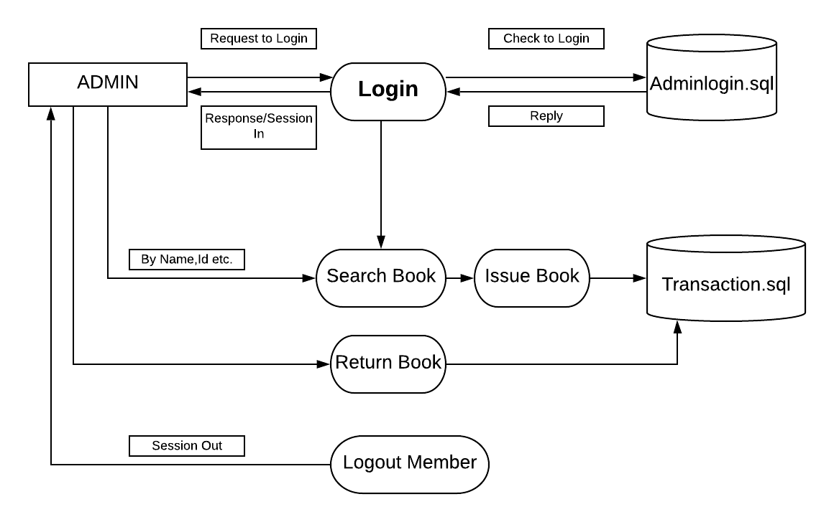
Admin Panel(Transaction) DFD – 1st Level

